Slide 1
Buffer Overflow Attacks
Heap and Stack
Lance West

Slide 2
Memory Vulnerabilities
Memory plays a key part in many computer system functions.
It’s a critical component to many internal operations.
From mother board operations, to monitor and I/O devices.
If the software that manages these systems can be corrupted.
If could give the attacker key access to many computer functions.

Slide 3
Conditions for Buffer Overflows
Using unsafe C functions without any protection code.
The program does not validate the input.
The return address is adjacent to the program’s code and data.
There is a suitable program to exploit the vulnerability.

Slide 4
Using Unsafe Functions
Unsafe C functions are functions that do not check for bounds when copying or moving data
Will not explicitly terminate a string in memory where it should be terminated
This problem is mostly related to string and character manipulation such as gets() and strcpy().
Programmers need to check boundaries to have effective garbage collection in code.

Slide 5
Checking the Boundary
#include <unistd.h>
int main(int argc, char **argv)
{
/* declare a buffer with max 512 bytes in size*/
char mybuff[512];
/* verify the input */
if(argc < 2)
{
printf("Usage: %s <string_input_expected>\n", argv[0]);
exit (0);
}
if (strlen(argv[1]) > 512)
exit (1);
/* else if there is an input, copy the string into the buffer */
strcpy(mybuff, argv[1]);
/* display the buffer's content */
printf("Buffer's content: %s\n", mybuff);
return 0;
}
Simply adding extra code to check the boundary.
If the boundary is violated, the program will just exit.

Slide 6
Input Validation
Input validation also can be implemented in the program to stop the buffer overflows
Problem is, not all the input combinations can be tested
Based on the types of interfaces the application will use?
Enhancing validating inputs with something like this shown on the next page.

Slide 7
Input Validation
The previous code can be enhanced further by validating inputs of common characters people might input.
if (strlen(argv[1]) > 512)
if(element_of_argv[1] == NOP && element_of_argv[1] == "sh" && ...)
if(last_argv[1]_element != '\0')
exit (1);
In addition, if its a web form, check the controls validation rules for default settings.

Slide 8
Return Address Adjacent to Code and Data
Depending how you compile your code some compliers will place return address adjacent to the program’s data and code.
Moreover, based on what environment your program will run in. Unix, Window….etc.
Each environment will have setup options that will help you stop Buffer Overflow problems.
So during the analysis phase of development, know what you can and cannot do based on the environment your program will live in.

Slide 9
Suitable Exploit Code Availability
Test your code for suitable exploits and have built in termination protocols.
Know what types of shell-scripts one might create to start a Buffer Overflow incident within your environment.
In addition, how might these scripts be used to overwrite return addresses?
What tools does the environment offer to protect your software, and what might you have to built into your program.

Slide 10
Detection and Prevention
The following Figure shows a block diagram for computer system detection and prevention at various stages
Secure coding practices, using secure library, simple check list, etc
/GS options, canary, warning messages, encrypt the return address, storing return add as different locations, etc
Kernel patch – SE-Linux (Role Based and Code Based Security Access, Exec-Shield – address space randomization. Patch-Guard, etc
NX/XD bit flag. Control Registers (CR) Memory Management Unit (MMU), etc.
Non- executable flag, etc
Intrusion Detection System (IDS), firewall, etc

Slide 11
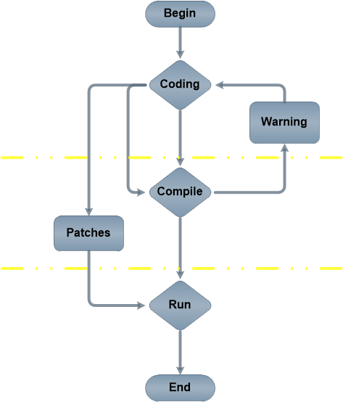
Coding Stage
Part A, The programmer role. Programmers must know and practice secure coding
Part B, The compiler, OS, memory and processor roles to detect and/or prevent buffer overflow
Part C, Memory management, processor and OS play a roles to help prevent the buffer overflow
Part A
Part B
Part C

Slide 12
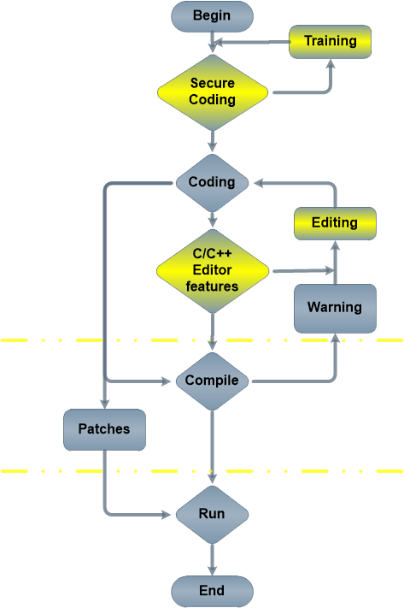
Best Practices Diagram
Part A, This diagram shows best practices for training and editing code
Part A, Also is where Secure code and testing should take place before compiling.
Part A
Part B
Part C

Slide 13
Conclusion
The last diagram incorporates secure coding knowledge and enhancing the editor for best practices.
The buffer overflow vulnerability and exploit are best taught by example using unsafe C code.
Some of the newer compliers like Visual Studio have intellisense installed and will point out coding problems relating to Buffer Overflows.
Others will not have advance features like this, so training will be key for programmers.

Slide 14
The End

