Slide 1
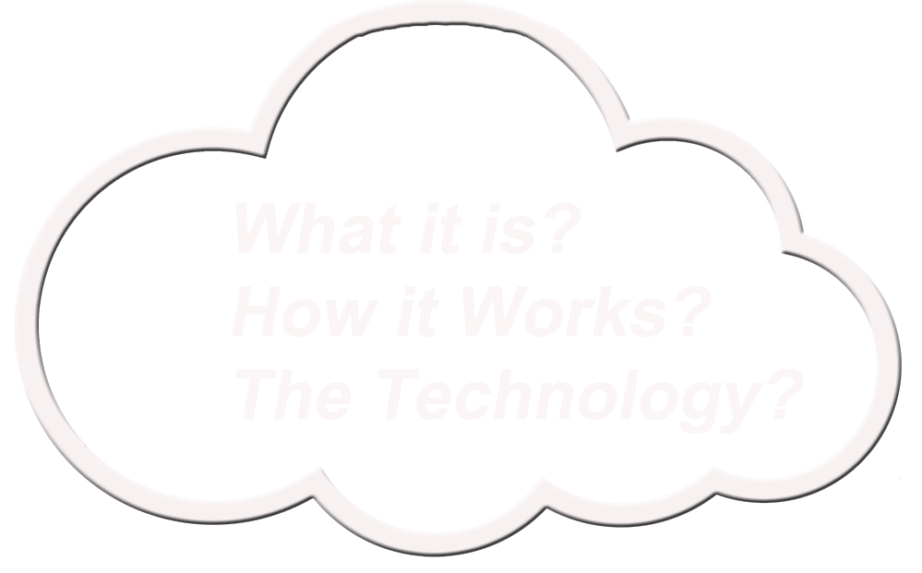

Slide 2
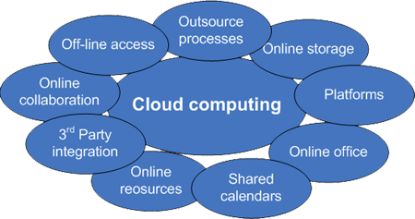
Cloud Computing is still a new topology with many possible
configurations and benefits for both large
and small organizations.
But the Question remains?
1. What is right for you, and what
should I look for in a Cloud Provider?
2. From Security, and Configurations, to Government Regulations.
People….Processes….and Technology…!

Slide 3
Table of Content
Types of Cloud Deployments: Private - Hybrid – Public - Community
The benefits of Cloud Computing Networks.
3) The Basic Cloud Architecture Design/CSA Reference Model Components
4) The Different types of Cloud Environments
Software as a Service (SaaS)
Platform as a Service (PaaS)
Infrastructure as a Service (IaaS)
Identity as a Service (IDaaS)
- OAuth 1 and 2, KAoS, OpenID, SCIM, SWRL..etc – models
- Identity Models and Standards
- X.812 Standard
5) Audit and Logging for Cloud Security

Slide 4
Table of Content
6) Hypervisor – Type I and Type II
Locking Down the Hypervisor
Virtual Attacks and Hacks on Hypervisors
7) Security and Risks – ENISA and NIST Guidelines
Vendor Lock-In
Loss of Governance
Compliance
Isolation Failure
People, Processes, and Technology Risks
Lawsuits
Changes of Jurisdiction
Network Mismanagement
Modification of Network Traffic
Architecture Designs
8) Data Security and Life Cycle
9) Application Security

Slide 5
Table of Content
10) Documentation Security
11) Facility Security
Physical Security and your Cloud provider's facility
Restricted Areas
Intrusion Detection
Fire prevention
Fencing
Guards
12) Security and Risk Strategies
SABSA (Sherwood Applied Business Security Architecture.
13) Audits and Reports – Trust but Verify within the SLA
14) File Sharing and Storage – SAN / NAS / RAIDS

Slide 6
Types of Cloud Deployments
Private-cloud: Can be used, built by internal staff at an internal data center for exclusive use by a single organization or business. It is then owned and operated by the organization or some combination. This can be expensive, but it does give the owner complete control over access control, security, governing, and audit oversight..
Hybrid-Cloud: This type is where application, storage and services reside both internally, and externally. This infrastructure can be a composite of (private, public, or community). The components are bound together by technology that can enable data and application portability sharing, along with load balancing across cloud environments.
Public-Cloud: Where application, and storage are hosted outside of the organizations environment. It might be more cost effective, but this will depend on the service provider and the Service Level Agreement (SLA). This type of cloud infrastructure is open to the public and is operated by government, business or academic organizations for the benefit of the public.
Community-Cloud: Is designed for exclusive use by a specific organizations or groups who have shared interests and focus; created on-site or off-site. It can be a combination of the above outlines for cloud deployments.

Slide 7
The benefits of Cloud Computing Networks
Cost effectiveness; no need to keep updating or managing software you have to
buy licenses for each year? The applications are already running in the cloud,
up-to-date and patched, ready to be accessed from anyplace on the plant
Time savings; it brings communication to a whole new level between
Users, Vendors, and Business Partners - which will save time and money.
Agility and flexibility; easy access to the latest in technology for user and
clients. Additionally, if done right can also facilitate a global learning environment
about your products and services.
Mobility for everyone; Users can upload documents to multimedia
presentations, letting them interact in real-time with clients across the globe.
Financial cost; There are three types of costs: hard costs that take costs
out immediately, soft costs that take out costs over time, and growth
costs which can have a big impact on future revenue.
Added future Bonus; with the new Borg implants we can all be connected to the collective,
and share our thoughts. But then again..that might not be a good idea.

Slide 8
Basic Cloud Architecture Overview (SaaS, PaaS, IaaS)

Slide 9
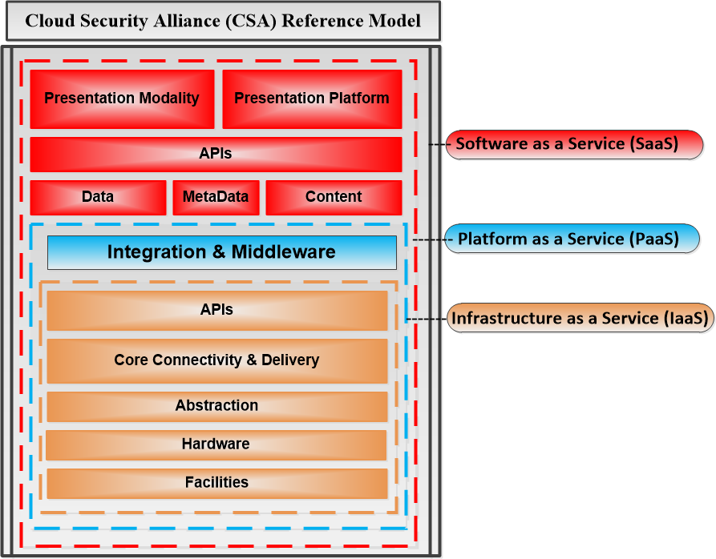
Cloud Architecture Overview (SaaS, PaaS, IaaS)
Figure 1

Slide 10
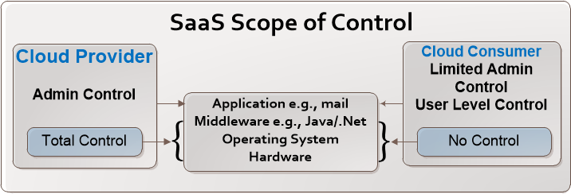
Software as a Service (SaaS)
The Cloud by its nature is a model for enabling convenient, with on demand network
access and sharing of computing resources (e.g., networks, servers, storage, apps,
and services). That can be rapidly provisioned and released with minimal management
effort or service provider input.
Nothing better reflex’s that design more then SaaS in which the Cloud provider is
responsible for deploying, configuring, updating, and managing the applications
in the cloud. The consumer will have limited administration control within this type
of scenario.
Figure 2

Slide 11
Software as a Service (SaaS)
SaaS gives the consumer the rights to use the provider’s applications running on a cloud infrastructure usually accessed through a client interface such as a Web browser.
Key things to keep in mind is the software supported and tested?
Is the software scalable to increasingly larger workloads?
How is security setup within the applications?
Is the database scalable, and how will access management be setup?
Who has control and management responsibilities or is this shared?

Slide 12
Software as a Service (SaaS)
Five key benefits of SaaS clouds:
Software Tool Footprint:
The Cost of Software up keep is reduced, and software can be accessed without installation costs.
Efficient Use of Software Licenses - no need to purchase extra licenses for separate computers.
Centralized Management - SaaS providers is supplying professional management, and one centralizated location of data for compliance checking, security, and backup.
Managed Platform Responsibilities - consumer is not involved with day-to-day management of infrastructure. Ex: patches, maintenance, hardware updates, physical security...etc
Up-front cost saving - no up-front costs relating to equipment acquisition, recurring usage fees, and added power usage.

Slide 13
Software as a Service (SaaS)
Federal recommendations for Software as a Service (SaaS) Documents
NIST publications:
FIPS 199 - Standards for Security Categorization of Federal Information and Information Systems
FIPS 200 - Minimum Security Requirements for Federal Information and Information Systems
SP 800-53 - Recommended Security Controls for Federal Information Systems
SP 800-144 - Guidelines on Security and Privacy in Public Cloud Computing

Slide 14
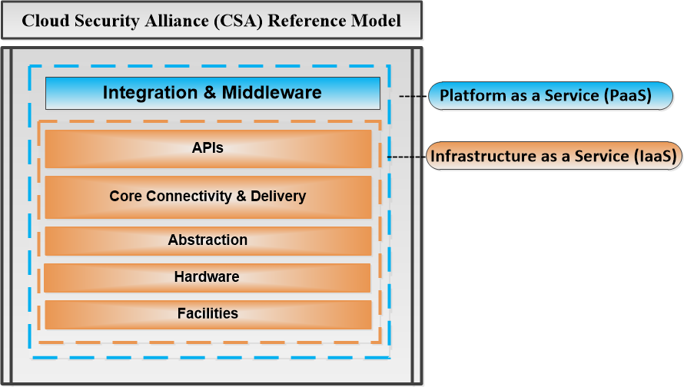
Platform as a Service (PaaS)
In PaaS in which the consumer is typically
developers/administrators who design, test
and implement application software.
Developers can run applications in various
testing environments, and administrators
can configure, tune, and monitor application.
Figure 3
Application users, who deployed on a PaaS to end users typically can access it in the same way as in any SaaS environment, meaning through some type of Web Interface or thin client.
PaaS provides tools to develop, test, deploy and administer applications.
Fees typically depend on developers vs. application end users? Which usually are calculated based on storage, processing, and network resources consumed.

Slide 15
Platform as a Service (PaaS)
Concerns and Issues to Consider
Since accessing it through a browser; Browser-Based risks are a concern.
Network Dependence, and lack of portability between PaaS Cloud environments.
Variations in services, and platform setups could be a problem between providers if you move an application developed on a specific platform.
Example: When comparing an application developed within an isolated business platform, and one build in the cloud could expose you to network security and hardware risk if the setup is not documented well for Server/App configuration?
PaaS can also require the use of multiple languages and Web resources opening your application to unknown vulnerabilities and attacks?

Slide 16
Platform as a Service (PaaS)
Platform specific questions to ask
Choose a PaaS that uses standard languages, tools, and extensions.
Choose a PaaS with standard data access protocols, and procedures.
Know how your data is protected? Data location, configuration of the databases and does it meet with confidentiality, compliance, integrity and availability rules?
What government regulation and rules need to be followed for financial reporting, and due care?
What type of application frameworks does the PaaS use? Tools and architecture to handle security tracking, mitigation, and reporting?
Does the PaaS follow any international standard - ITIL, Six Sigma, Capability Maturity Model (CMMI), CobiT...etc?
Most Importantly: Secure Data Deletion – Technology and Controls used?

Slide 17
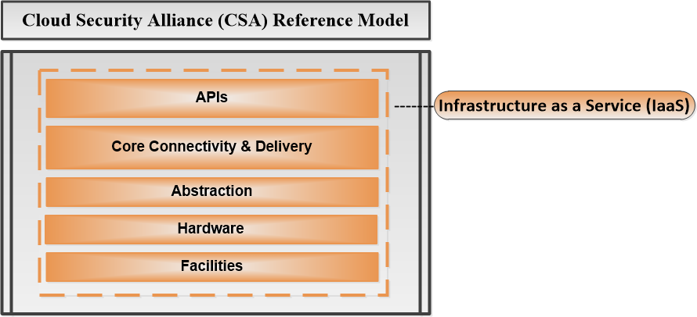
Infrastructure as a Service (IaaS)
IaaS Cloud can if designed correctly provide one with a platform that is reliability, compliant, and secure, but if you’re the one that has to manage it – do you have the skill-set?
Because for the most part a consumer of any IaaS Cloud is also the system administrator.
Figure 4
A typical IaaS provides virtual computers, storage, and network infrastructure components.
Typically fees are calculated based on GB storage per hour, CPU usage, bandwidth, IP addresses, and other value-added services.

Slide 18
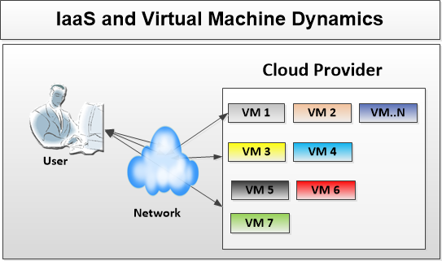
Infrastructure as a Service (IaaS)
Six important characteristics of IaaS:
1) Abstract Interaction Dynamics – This feature can give a consumer access to a large number of Virtual Machines. In addition, a consumer will be provided with persistent data storage and a stable network connection.
Figure 5

Slide 19
Infrastructure as a Service (IaaS)
Six important characteristics of IaaS:
2) Software Stack and Scope of Control - The provider will control most privileges, but overall control and management responsibilities will have to be worked out as to sharing of security and access to create virtual boxes.
In IaaS, the operating system is split into two layers. The upper layers hold the Application, Middleware, and Guest operating systems. The lower layer is the Virtual Machines Monitor (VMM), which is called the hypervisor. A hypervisor uses the hardware to synthesize Virtual Boxes and isolates them from the real machine. (See Figure 6)
If running multiple Virtual Boxes which are seen as guest operating systems; take a look at NIST SP800-125 which should help you with setting up guidelines and policies.
The service level agreement (SLA) should outline the number and Virtual Boxes one can create and overall management responsibilities.

Slide 20
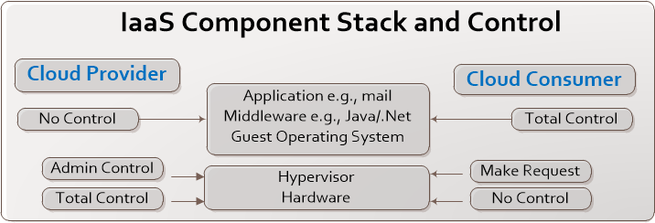
Infrastructure as a Service (IaaS)
3) Operational Designs - A cloud is a proprietary environment and details about its technical architecture and algorithms are not always open to review; Below is a simplified IaaS Cloud Architecture. (Figure 7 is a standard infrastructure design).
IaaS Component Stack and Controls
Figure 6
The provider keeps control over the hardware and Administration of the hypervisor
layer. The consumer makes requests to create and manage new VMs.

Slide 21
Infrastructure as a Service (IaaS)
4) Benefits - Benefits - The IaaS platform places more responsibilities on the consumer, since the consumer is tasked with managing the VMs and Virtualized infrastructure. Moreover, they are tasked with many of the system administration work above the hypervisor layer, but this would depend on the consumers skill-set and needs laid out within the Service Level Agreement (SLA).
5) Issues - IaaS clouds depend on a secure network, and a secure reliable browser for account administration, which is also one of it risk factors. In addition, IaaS allowing consumers to create and retain many VMs in various states; meaning if not well maintained can lead to security issues on out-of-data configurations leading to security leaks and a compromised platform.
6) Concerns - Browsers will typically use public key cryptography to establish a link to the cloud, but its the consumer’s responsibility to check that the private link is not with an imposter. Also IaaS clouds typically uses a hypervisor in combination with hardware to split each physical computer into multiple virtual machines and Isolation of the virtual machines depends on the correct implementation and configuration. In the last few years major flaws in hypervisors technology have been found.

Slide 22
Infrastructure as a Service (IaaS)
Figure 7

Slide 23
Infrastructure as a Service (IaaS)
Infrastructure as a Service (IaaS)
In the above graphic the Cloud Manager is the public access point to the cloud,
which includes authenticating and generating access credentials.
The Cloud Manager connects to the Data Object Storage (DOS) repository.
DOS services need to be available to run virtual machines and to connect
from outside of the cloud.
In addition to being connected to individual computers via LAN links, Cloud
Manager also connect to Persistent Local Storage (PLS).
In the lowest layers of the hierarchy we have the hypervisor which cooperates with
the Computer Manager.
Each Manager is responding to the Cluster Manager as its getting queried
back and forth. The Computer Manager also keeps track of the number of virtual
machines running, and how many can be started.

Slide 24
Infrastructure as a Service (IaaS)
Infrastructure as a Service (IaaS)
IaaS places more responsibility on the client then the other cloud platforms
like SaaS and PaaS.
In IaaS the consumer manages the VMs and virtualized infrastructure
and can perform most of the administration work.
In addition, IaaS can allow the client to run operating systems like Web servers,
Email servers, and Databases within the virtual platform.
They could also have rights to create other user-facing applications.
But if the application requires specialized hardware that might not be allowed?
NIST Documentation and guidelines on IaaS:
NIST standards and special publications (e.g. FIPS 199, FIPS 200, SP 800-53, etc.)

Slide 25
Identity as a Service (IDaaS)
IDaaS is a combination of administration and account provisioning, providing identity
and access management functions along with reporting services like User
Authentication, Single-Sign-On (SSO), and authorization enforcement. In addition,
to logging events, reporting on who accessed what and when?
Moreover, IDaaS can function as digital entity management which can be used during
electronic transactions between website transactions, transaction participants, and
clients.
In Short; The Cloud Security Alliance defines IDaaS as, “the management of
identities in the cloud, apart from the applications and providers that use them.”
NIST Special Publication 500-299 (NIST Cloud Computing Security Reference
Architecture)
NIST Special Publication 500-292 ( NIST Cloud Computing Reference Architecture)
NIST SP800-53 (Security and Privacy Controls for Federal Information Systems and
Organizations.

Slide 26
Identity as a Service (IDaaS)
6 Major Benefits of Common Identity Services and Standards:
1. Single Sign-on (SSO) Authentication
2. Federation – Federated identity is where identity and authorization settings are
collected from other multiple identity management systems, enabling different
systems to define user access.
3. Granular Authorization Controls – Access is typically not an all-or-nothing
proposition; each user is allowed access to a subset of functions and data stored
in the cloud
4. Administration – Administrators generally prefer a single management panel for
administering users and managing identity across multiple services which can
save time if one has to code and manage their own custom setup.

Slide 27
Identity as a Service (IDaaS)
5. Integration with Internal Directory Services – Cloud Identity and Access Management (IAM) systems rely on integration with in-house LDAP, Active Directory, HR systems, and other services to replicate existing employee identity, roles, and groups into cloud services
6. Integration with External Services – One of the core benefits of a cloud IAM provider is it offers connections to common cloud services so you do not need to write your own integration interface. By offering pre-built connections to common SaaS, PaaS, and IaaS vendors, integration with new service is both easier and faster.
Key Identity and Access Management (IAM) related emerging standards:
- X.812 Standard - Security Assertion Markup Language (SAML) - eXtensible Access Control Markup Language (XACML) - Service Provisioning Markup Language (SPML)
- IDaaS emerging standards (OAuth, KaoS, OpenID, SCIM, SWRL etc.)

Slide 28
Identity as a Service (IDaaS) past/future encryption and access standards
The basic web encryption standard was SSL, replaced with TLS 3.0
TLS stands for Transport Layer Security, (formerly known as SSL) which is your basic authentication framework with language libraries one can integrate into your web platform. Its a Base64 encoded protocol one should have setup for sending and receiving usernames and passwords.
OAuth1.0a - is a far more secure protocol and uses an cryptographic signature (HMAC-SHA1) value that combines the token secret. OAuth 1.0 never directly passes the token secret across the wire, making it hard for one to see the password in transit. In the past generating and validating the signature was a complex operation, but now days most modern computer languages have libraries designed to help you automate the process.
OAuth 1.0 can also be used without TLS/SSL, but that is not recommend if the data is sensitive.

Slide 29
Identity as a Service (IDaaS) past/future encryption and access standards
OAuth2 - removes signatures, so the use of a cryptographic algorithms to create, and validate signature is not needed. Its now handled by TLS which is the new standard mandated by the Payment Card Industry (PCI).
KAoS - is an effort to bring policy management to a whole new level using a Semantic Web Language like OWL. Policies designed with KAoS are a means to dynamically constrain and regulate a system's behavior without changing code or requiring the cooperation of the components being governed. Because KAoS supports both authorization and obligation policies it has many benefits from reusability, efficiency in helping to protect your buggy components and understanding their behaviors.
OpenID - OpenID is a protocol for authentication while OAuth is for authorization. OpenID is a simple identity layer on top of the OAuth protocol. It verifies the identity of the End-User based on the authentication performed by the Authorization Server. OpenID for example, allows a clients to authenticate to web-based systems as well as receiving information about authenticated sessions and end-users.

Slide 30
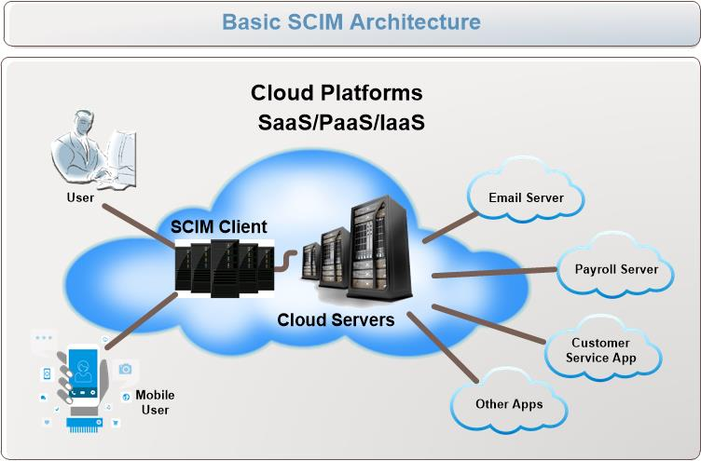
Identity as a Service (IDaaS) past/future encryption and access standards
System for Cross-Domain Identity Management (SCIM) - is a standard that defines schema and protocol for identity management. The SCIM makes it more convenient for users to move in and out of the Cloud. It emphasis simplicity for development and integration in existing authentication, authorization, and privacy models.
SCIM Components:
Core Schema model provides
users and groups context of
cloud Apps. Using JSON and XML.
2) Defines a REST API for
Exchanging Users and resources.
3) Binding SAML to protocols
other then the SCIM REST API.
Figure 8

Slide 31
Identity as a Service (IDaaS) past/future encryption and access standards
Semantic Web Rule Language (SWRL) - is a language used for in Semantic Web because it can express logic. Its a form of xml/text based Markup Language based on OWL in which all the rules are express in terms of OWL concepts; Classes, Properties, Events, and Literals)
Service Provisioning Markup Language (SPML) - is an XML based language for exchanging user information between cooperating organizations and businesses. It is being developed by Advancing Open Standards for the Information Society (OASIS), and allows you to securely create user interfaces for Web Services, generating requests from applications and across platforms within enterprise environments.
Security Assertion Markup Language (SAML) - SAML is an open standard XML based language used for exchanging authentication and authorization data between an identity provider and a service provider. SAML addresses the need for web browser single sign-on (SSO). SAML provides three types of statements during deployment: Authentication, Attribute and Authorization decision statements. The expressiveness of authorization decision statements in SAML is limited so for more advanced use cases many recommend using XACML.

Slide 32
Identity as a Service (IDaaS) past/future encryption and access standards
eXtensible Access Control Markup Language (XACML) - XACML is also an
open standard XML based language design to express security policies and access
rights. This protocol is widely deployed adding to its Interoperability with other
applications using the same standard language. Its also more generic and easier
for many environments to implement and utilize across platforms. This meaning
a policy written on one group can manage sub-pieces of policies relating to other
Group policies; because XACML knows how to correctly combine the results into a
single policy decision making engine making it a very flexible language.
X.812 Standard - This Access Control Framework is a model for All types of Access
Controls built on an Open System architecture. It outlines authentication and Audit
structures, as well as management requirements. If you want to learn more follow
the link because its a very important standards one should follow when using IDaaS.
https://www.itu.int/rec/T-REC-X.812-199511-I/en

Slide 33
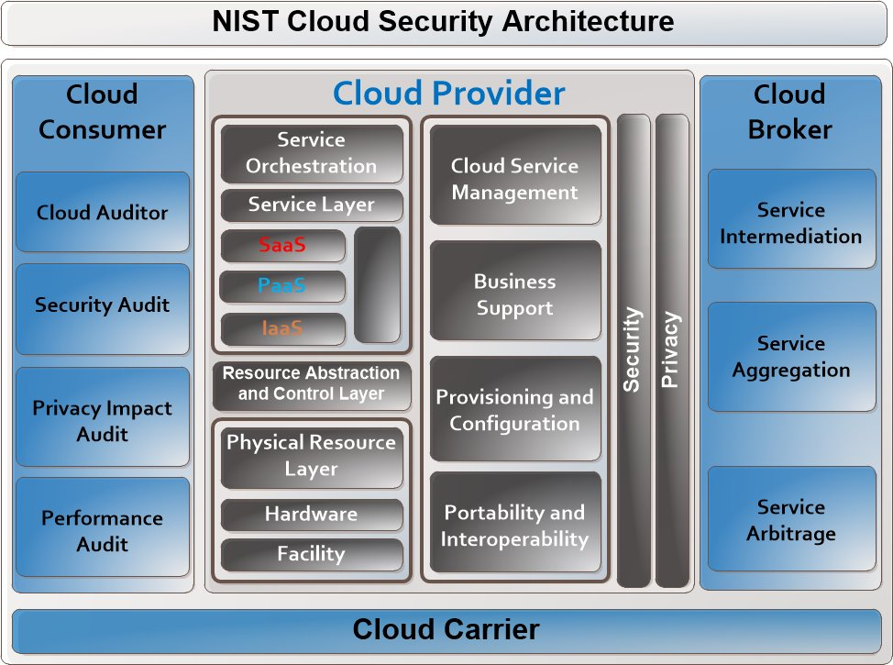

Slide 34
Other Issues in Security
Identity Protection - The user is the weakest link in the security structure. If you enable the process of logging into the cloud network as transparent as possible, yet providing strong encryptions and access controls. The user will be able to use their devices from anywhere at any time with little effort, and in return they will not resort to trying to circumvent the process.
Data Protection - Identity protection is one thing, but Data protection is everything. The cloud network has to have a comprehensive protection plan in place to discover, monitor and safeguard the Data as it goes across multiple environments. A Data protection solution should support granular content-aware policies that are easy to follow with detailed security protocols on how data should be stored and handled.
Tracking Engines – There are many types of computer management engines or correlation methods one can use to identity and alert administrators to problems. The more real-time the system is the better you will be able to react and remediate the damage because - YOU WILL BE HACKED.! It’s just a question as to what degree and how quickly you can recover to stop it from happening again.

Slide 35
Audit and Logging for Cloud Security
Audit Logging and Tracking – Logging is your first line of defense. It will help in spotting malware, escalated privileges and other behaviors your SIEM or other IDS/IPS systems might not catch.
Command line logging will capture details of a hacker and can now even track
what is input into the command-line application itself.
Good logging standards can also help with Compliance and Regulatory requires when it comes to auditing and certifications.
Templates for proper setup and Logging of your systems in the cloud.
“Windows Splunk Logging Cheat Sheet”
NIST guidelines:
NIST Guide to Computer Security Log Management SP800-92.pdf
OWASP Logging Cheat Sheets: - https://www.owasp.org/index.php/Logging_Cheat_Sheet
https://www.owasp.org/index.php/OWASP_Top_Ten_Cheat_Sheet

Slide 36
Other Issues in Cloud Security
Storing data in more then one location can increase the risk of unauthorized physical access. It can be mitigated by encrypting the data before uploading it to the cloud.
People and access to your data? People can be bribed or encryption keys stolen. Who controls these keys and where are they stored?
Your data is traveling over a number of networks on its way to the cloud. Data stored on a cloud requires a WAN network to connect your LAN to its SAN?
Faulty equipment, or virtual environment can leave you open to other customers, to criminals getting access to your data?
Notes:
.

Slide 37
Other Issues in Cloud Security
Having an Intrusion detection system (IDS) or Intrusion
prevention system (IPS) could help elevate some of these
security problems, but a lot depends on how its configured?
In-Band or Out-of-Band? Important differences between IDS and IPS systems depending on where you want to deploy them?
Out-of-Band: means the system is not deployed in the middle of the communications path of your data and does not effect performance.
In-Band: meaning that it is deployed in the middle of the communication path. Which can effect the performance slowing down normal processing. On the other hand you will be able to detect and react more quickly to outside attacks.
Notes:
While math and science Graduate students may require additional application functionality, most Business, Social Science and Liberal Arts students primarily need tools in creating, analyzing and presenting their areas of study.
Competency means that the student can install software, create accounts, manage files, etc.
Internet access becomes more available every day through public (cities, schools, etc.) and private (ISPs, phone carriers, etc.) sources.

Slide 38
Other Issues in Cloud Security
Intrusion systems techniques
Signature or Pattern-Matching systems – Examines logs and network
traffic to determine if it matches any known attacks.
Protocol Anomaly Based systems – Examine network traffic based on
defined standards and policy protocols you setup.
Statistical Anomaly Based systems – Establish baselines of normal
traffic patterns over time and if it finds any deviations from that baseline it
sets off an alarm.
Most systems now days combine two or more of the above methods, and
some even have build in heuristics algorithms' – studying the behavior of the
network traffic. But Testing and knowing if the heuristics algorithm is working
or not is a big question?
Notes:
While math and science Graduate students may require additional application functionality, most Business, Social Science and Liberal Arts students primarily need tools in creating, analyzing and presenting their areas of study.
Competency means that the student can install software, create accounts, manage files, etc.
Internet access becomes more available every day through public (cities, schools, etc.) and private (ISPs, phone carriers, etc.) sources.

Slide 39
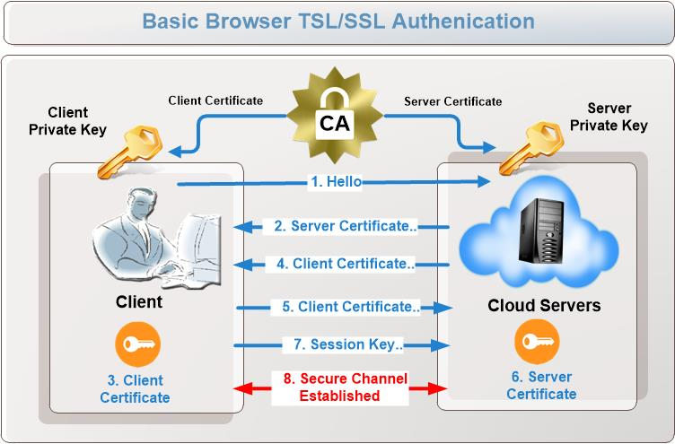
Browser Security and Access
SaaS clouds relay on consumer browsers to be both reliable and
secure. So one should understand just how TLS/SSL security works.

Slide 40
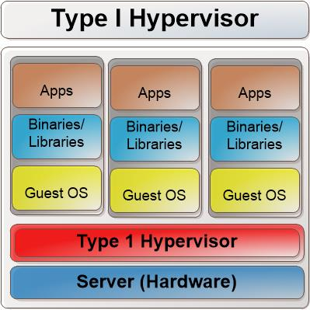
Hypervisors – Type I and Type II
Type I Hypervisor
The Type I Hypervisor sets on top of
the host hardware and is often called
Bare-Metal Hypervisor, because it
communicates directly with the
Hardware.
It may or may not run faster depending on
your hardware setup, configuration and
memory installed. However, hardware
configuration issues aside it might be
more secure if your data is very sensitive.

Slide 41
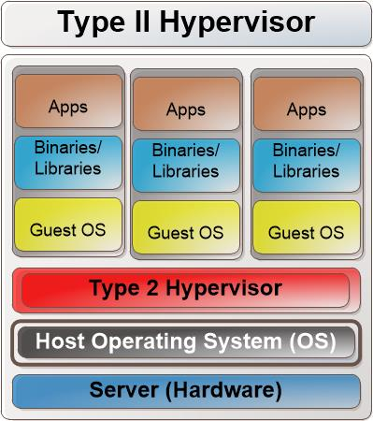
Hypervisors – Type I and Type II
Type II Hypervisor
Type II Hypervisor runs as an application
on the host operating system. It runs on top
of the hardware and does not directly
interacting with it. It relies on the host
Operating System for that function.
So any OS system you install
within the virtual environment, is going
through the Hypervisor to the host
operating system that interacts with the
the servers hardware components.

Slide 42
Hypervisors – Type I and Type II
Virtual Attacks and Hacks on Hypervisors - Virtualized Operating systems are
the most common, but their are many forms to virtualization and each have their
own vulnerabilities and concerns one needs to research.
Virtual machine Guest Hardening
Hypervisor Security
Inter-VM attacks and blind Spots
Performance Concerns
Operational Complexity from VM sprawl
Instant On Gaps
Virtual Machine Encryption
Data Comingling
Virtual Machine Data Destruction
Virtual Machine Image Tampering
In-Motion Virtual Machines
National Vulnerability Database
https://goo.gl/RXMO7V
Cloud Security Alliance
https://cloudsecurityalliance.org/

Slide 43
Hypervisors – Type I and Type II
Locking Down the Hypervisor – NIST 800-125a Standards
The NIST 800-125a outlines five base line methods to lockdown the Hypervisor
HY-BF1: Execution Isolation for Virtual Machines
Memory Management, context switching between various processor states during the running of applications in VMs
2. HY-BF2: Device Emulation & Access Control
Emulating all Network & storage devices that different native drivers i VMs are expecting, mediating access to physical devices by different VMs
3. HY-BF3: Execution of Privileged Operations
Certain operations invoked by Guest OS, may have to be executed by the hypervisor, instead of the host hardware.
4. HY-BF4: Management of VM’s
Setting and Monitoring configuration parameters of VMs states
HY-BF5: Administration of Hypervisor Host & Software
Configure correct parameters for user interactions with hypervisor host and software within the Virtual Network.

Slide 44
ENISA Security & Risk Concerns
ENISA Questions
Vendor Lock-In | Custom Built Applications and Design architectures unique to that provider . If you move it may required a total rewrite of your applications and databases or worst your apps will stop working?
Loss of Governance | Loss of control over key business processes that could effect your profits or cause you to loss business.
Compliance | Depending on the business, Government Regulations and Reporting controls might be a critical process that is best not left in the hands of your Provider.
Isolation Failure | Access to your data is stolen, hacked, copied or corrupted.
People/Process Risks | People have not been properly cleared, and processes like upgrading and patching systems not clearly designed and controlled.
Lawsuits | Interstate commerce is controlled by congress, but each state does have their own laws and regulation relating to tax, insurance, business structures…etc - if something should happen?
Changes of Jurisdiction | International Laws, Due Care and Safe Harbor Rules and Regulations. Also lets not forget local and state laws.
Network Mismanagement | People and Process mistakes.
Modification of Network Traffic | Communication of changes to the network and effects it might have on your business.
Architecture Designs | Few Providers will display how their cloud is designed

Slide 45
ENISA Security & Risk Concerns
Technical Risks
Resource Exhaustion
Hypervisor Failure, Hacked, or MisConfigured
Malicious Cloud Provider Insider
Management Interface Compromise
Intercepting data in Transit
Data Leakage
Insecure or incomplete data deletion
Distributed Denial of Service
Economic Denial of Service
Loss of Encryption Keys
Malicious Probes or Scans
Compromise of Service Engine
Hardening requirements Conflict with Cloud

Slide 46
Data Security and its Life Cycle
Data Life Cycle
Create - The generation of digital media content, alteration/updating/modifying or
converting it to another format.
Store - Storing the data into a secure repository for easy access in a usable format
Use - Viewed, processed, or some other activities
Sharing - Between users, customers, and partners
Archive - Long-term storage
Destroy - physically erase by crypto-shredding or some other secure means.

Slide 47
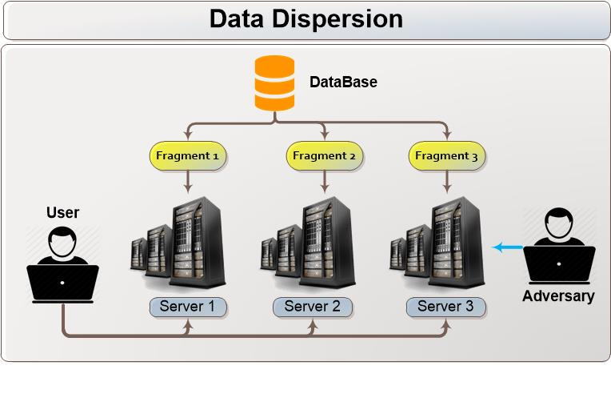
Data Security and its Life Cycle
Data Security must also include governance policies, and key technologies to
protect and monitor it, like encryption and specialized techniques like data dispersion.
Data Dispersion: is a newer technique that splits data into segments and stores them on different cloud servers. If a hacker gets access to one segments its meaningless without access to the other segments.
In addition each segment of the dispersion algorithm can be encrypted to further protect the data.

Slide 48
Application Security
Cloud Security Alliance (CSA) recommendation
Ensure that best practices of application security, identity management, data
management, and privacy are developed from the beginning within your software
development Life Cycle (SDLC)
Penetration testing will give you insight into the strength of your applications and
network security. It will also highlight poor or improper application and system
Configurations and bugs.
Interoperability testing - test to see if you application works with other components
in the cloud and can exchange data via common sets of exchange formats.
Any application security assurance program should collect metrics to ensure that
applications are performing as designed.
The Cloud Security Alliance - Outlines best practices for Application Security
https://cloudsecurityalliance.org/group/cloud-controls-matrix/

Slide 49
Documentation & Security in the Cloud
Documentation Requirements for the Cloud
BIA (Business Impact Analysis)
Max operational disruption of productivity,
Financial consideration
Regulatory
- Responsibilities and business reputation.
The BCP (Business Continuity Planning)
- Identifying regulatory and legal requirements that must be met - Identifying all possible vulnerabilities and threats - Estimating the possibilities of these threats and the loss potential - Performing a BIA - Outlining which departments, systems, and processes must be up and running before any others - Identifying interdependencies among departments and processes - Developing procedures and steps in resuming business after a disaster

Slide 50
Facility Security
Physical Security and your Cloud provider.
Restricted area, authorization methods, and controls
Motion detectors, sensors, and alarms
Intrusion detection
Fire detection, prevention, and suppression
Fencing, security guards, and security badge types
The different functionalities of security controls are preventive, detective, corrective, deterrent, recovery, and compensating.
Practice Defense-in-Depth: meaning Implementation of multiple control
levels making any compromise, physical or virtual a far more difficult task.

Slide 51
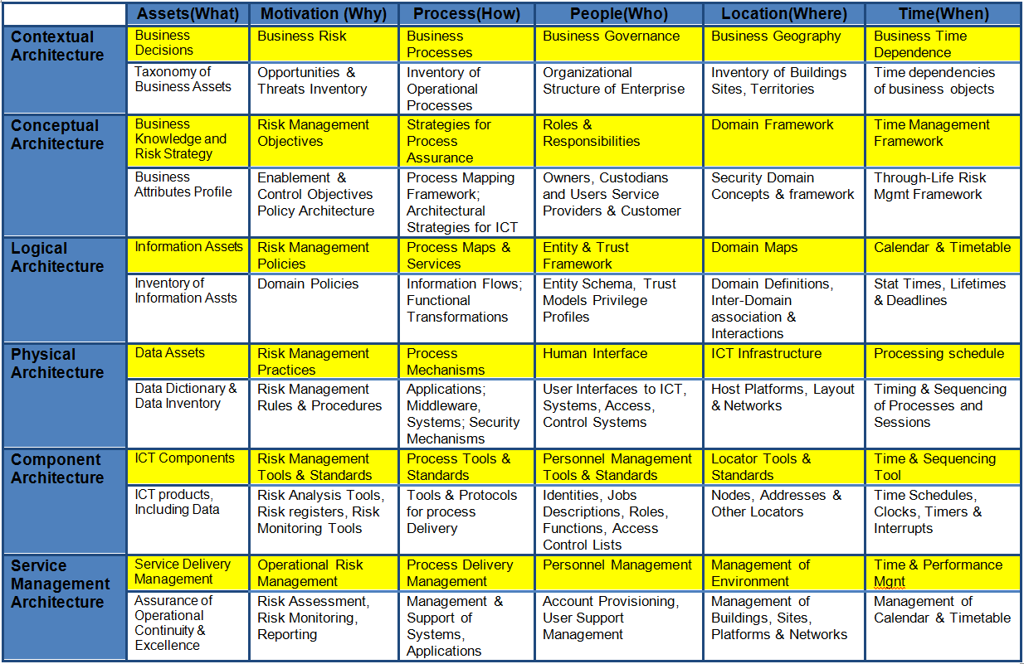
Security and Risk Strategies (SABSA)
SABSA (Sherwood Applied Business Security Architecture) is a framework
and methodology for enterprise security architecture and service management.

Slide 52
Audits and Reporting
Compliance and Audit Management - Trust but Verify within the Cloud
The Cloud Environment has its own special challenges from communication, regulations
to across site jurisdictions.
Pay Attention to any cross-border or multi-jurisdictional issues
Have clear guidelines for compliance and corporate governance between
stakeholders, directors and managers, below is some key document that will help.
Cloud Security Standards set out by the ISO/IEC and the ITU-T
ISO/IEC 27017: Cloud Computing Security and Privacy Management
System-Security Controls
ISO/IEC 27036-x: Multipart standard for the information security of suppliers
relationship management.
ITU-T X.ccsec: Security guideline for cloud computing in telecommunication area
ITU-T X.srfcts: Security requirements and framework of cloud-based
telecommunication service environment

Slide 53
File Sharing and Storage – SAN / NAS / RAIDS
Digital Data is stored in logical pools, which can span across multiple servers and even locations.
Most likely accessible by Web Service application interface (API’s) or some other Web-Based content management system.
Archival and Offline storage
Backups should be done on a regular basis, When/How/and in what order should be based on the requirements of the business.
Data that is needed only for historical purposes should be archived.
Recovery of backups should be well-defined and documented.

Slide 54
File Sharing and Storage – SAN / NAS / RAIDS
Types of Virtualized Storage systems
Host-based – Can require additional software running on the host in order to handle volume management , manage disk device drivers, intercepting the I/O requests, and providing for metadata lookup on I/O mapping schema’s.
Network-based – Operates on a network-based device (typically a standard server or smart switch) using iSCSI or Fibre Channel (FC) networks to connect as a SAN.
(SAN) Storage Area Networks: SANs can consists of blocks of storage devices from tape libraries, optical drives, and disk arrays platforms, utilizing iSCSI or Fibre operating systems as locally attached devices.
Notes:
While math and science Graduate students may require additional application functionality, most Business, Social Science and Liberal Arts students primarily need tools in creating, analyzing and presenting their areas of study.
Competency means that the student can install software, create accounts, manage files, etc.
Internet access becomes more available every day through public (cities, schools, etc.) and private (ISPs, phone carriers, etc.) sources.

Slide 55
File Sharing and Storage – SAN / NAS / RAIDS
(SAN) Storage Area Networks
SANs consists of dedicated block-level storage on dedicated networks
SANs can provide performance capacity, and scalability giving you the option to link to a large bank of disks via multiple systems connected by specialized controllers or via an Internet Protocol (IP) network.
SANs support disk mirroring, backup and restore capacities as well as archival and retrieval of data. They do not provide file abstraction, only block-level operations, but file systems build on top of the SANs do provide file-level access which are known as SAN file systems or shared-disk-file-systems!
Some of the SAN topologies - Point-to-point, arbitrated loop, and switched fabric topologies.

Slide 56
File Sharing and Storage – SAN / NAS / RAIDS
(NAS) - Network-Attached Storage
NAS is similar to a SAN network, but operates at the file level instead of the block-level. Its designed to store files and is mostly used for FTP servers and other types of file servers.
The network-attached storage device is attached to a local area network (typically, an Ethernet network) and assigned an IP address. File requests are mapped by the main server to the NAS file server.
NAS consists of hard disk storage which includes multi-disk RAID systems and software mapped to the different devices.
NAS can handle a number of protocols, like Microsoft's Internetwork Packet Exchange, NetBEUI and Novell.

Slide 57
File Sharing and Storage – SAN / NAS / RAIDS
RAIDs - Redundant Array of Independent Disks
Fault-tolerant grouping of disks that a server sees as a single disk volume; Combination of parity-checking, mirroring, striping, Self-contained, manageable unit of storage.
RAID 0: Striped set without parity/[Non-Redundant Array].
RAID 1: Mirrored set without parity.
RAID 2: Striped set with dedicated parity/Bit interleaved parity.
RAID 3: Striped set with dedicated parity/Bit interleaved parity.
RAID 4: Block level parity.
RAID 5: Striped set with distributed parity.
RAID 6: Striped set with dual distributed Parity.
RAID 0+1: (Mirrored Stripped)
RAID 1+0: (Stripped Mirrored)
Notes:
.

Slide 58
The End
Reference:
(NIST) National Institute of Standards and Technology Documents
KAoS Policy Management for Semantic Web Services: Austin Tate, Jeff Dalton, and Stuart Aitken, University of Edinburgh - www.swsi.org
SCIM Protocol - http://www.simplecloud.info/specs/draft-scim-rest-api-01.html
SCIM Core Schema - http://www.simplecloud.info/specs/draft-scim-core-schema-01.html
SCIM SAML Binding - http://www.simplecloud.info/specs/draft-scim-saml2-binding-02.html
SPML - http://www.oasis-open.org/committees/provision/
OAuth - http://oauth.net/
Cloud Security Alliance https://cloudsecurityalliance.org
European Union Agency for Network and Information Assurance
https://www.enisa.europa.eu/@@search?SearchableText=information+Assurance
NIST Cloud Computing Collaboration Site
http://collaborate.nist.gov/twiki-cloud-computing/bin/view/CloudComputing/
Book: Conquest in Cyberspace, Martin Libicki -- ISBN: 13: 978-0521692144 ISBN-10: 0521692148

